Slide 1
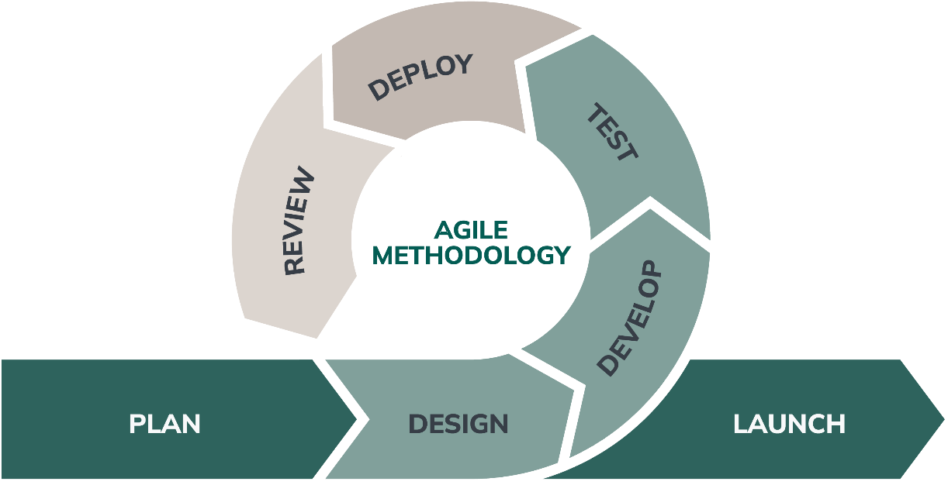
Agile Methodology
Understanding Agile's Role in Modern Project Management

Slide 2
Introduction
Agile methodology has emerged as a response to the limitations of traditional project management techniques. This presentation aims to explore Agile's definitions, principles, and benefits, shedding light on how it streamlines processes and enhances project outcomes.

Slide 3
01
Agile Overview

Slide 4

Definition of Agile
Agile is a project management approach characterized by its iterative and incremental development strategy.
It promotes flexibility and collaboration, allowing teams to adapt quickly to changing requirements. Agile empowers teams to deliver smaller portions of work rapidly and gather feedback to improve subsequent iterations.

Slide 5
Core Principles of Agile
The core principles of Agile are encapsulated in the Agile Manifesto, which emphasizes
1.individuals and interactions,
2. working software,
3. customer collaboration, and responding to change.
Agile encourages a culture of continuous improvement, where regular reflections and adjustments to processes foster enhanced productivity and quality.

Slide 6
Benefits of Agile Methodology
Agile methodology offers numerous benefits that enhance project performance.
1.It enables teams to respond swiftly to customer feedback and changing market conditions, fostering an adaptive environment. 2.Agile's incremental approach allows for continuous delivery of value and improved product quality.
3.Enhanced collaboration among team members leads to increased engagement and ownership, ultimately resulting in faster project timelines.

Slide 7
02
Comparison with Traditional Methods

Slide 8
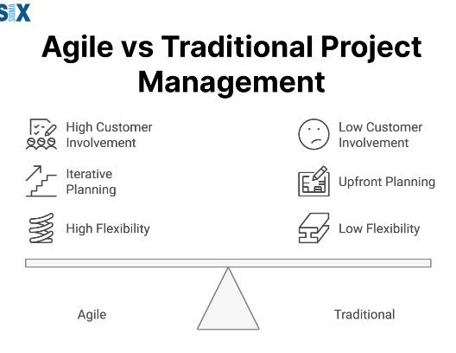
Agile's Advantages Over Traditional
Agile methodologies provide several advantages over traditional approaches, including flexibility, faster time to market, and enhanced collaboration. Unlike traditional methods, Agile promotes iterative progress, allowing teams to incorporate feedback continuously. This results in better alignment with customer needs and higher satisfaction levels. Agile also encourages cross-functional teamwork, leading to innovative solutions that address complex problems.

